Slide 1
Deep Learning
Or why you should just ask a computer to figure it out.

Slide 2
Convolutions
Linear Layers
1
1
2
2
3
3
4

Slide 3
Convolutions
Linear Layers
1
2
1
1
2
4
2
Does changing the order matter?
2
3
3
3
3
4
1

Slide 4
Convolutions
Translation invariance

Slide 5
Convolutions
Locality

Slide 6
Convolutions
1
1
1
1
1
1
1
0
-1
-1
1
1
0
Elementwise multiplication and then summation

Slide 7
Convolutions
1
1
1
1
1
1
1
1
0
=
-1
-1
1
1
0

Slide 8
Convolutions
1
1
1
1
1
0
1
1
0
0
=
-1
-1
1
1
0

Slide 9
Convolutions
1
1
1
1
1
0
1
1
0
0
=
-1
-1
-1
1
1
0

Slide 10
Convolutions
1
1
1
1
1
0
1
1
0
0
=
-1
-1
-1
-1
1
1
0

Slide 11
An excellent visualization
https://setosa.io/ev/image-kernels/

Slide 12
Padding
0
0
0
0
1
1
1
0
1
1
1
1
0
0
0
1
0
0
1
1
0
0
1
1
0

Slide 13
Padding
1
1
1
0
1
1
1
1
0
0
0
1
0
0
1
1
0
0
1
1
0
0
0
0
0

Slide 14
Padding
0
0
0
0
0
1
1
1
0
1
1
1
0
1
0
0
0
1
0
0
0
1
1
0
0
1
1
0
0
0
0
0
0
0

Slide 15
Padding
0
0
0
0
0
0
1
1
1
0
1
1
1
0
1
0
0
0
-1
-1
-1
=
0
1
1
0
0
0
0
0
0
0
0
0
0

Slide 16
Stride
How much to move the kernel?
0
0
0
0
0
0
0
0
0
0
0
1
1
1
0
0
1
1
1
0
0
1
0
0
0
0
1
0
0
0
0
1
1
0
0
0
1
1
0
0
0
0
0
0
0
0
0
0
0
0
Step 1
Step 2
Stride 1

Slide 17
Stride
How much to move the kernel?
0
0
0
0
0
0
0
0
0
0
0
1
1
1
0
0
1
1
1
0
0
1
0
0
0
0
1
0
0
0
0
1
1
0
0
0
1
1
0
0
0
0
0
0
0
0
0
0
0
0
Step 3
Step 4
Stride 1

Slide 18
Stride
How much to move the kernel?
0
0
0
0
0
0
0
0
0
0
0
1
1
1
0
0
1
1
1
0
0
1
0
0
0
0
1
0
0
0
0
1
1
0
0
0
1
1
0
0
0
0
0
0
0
0
0
0
0
0
Step 1
Step 2
Stride 2

Slide 19
Stride
How much to move the kernel?
0
0
0
0
0
0
0
0
0
0
0
1
1
1
0
0
1
1
1
0
0
1
0
0
0
0
1
0
0
0
0
1
1
0
0
0
1
1
0
0
0
0
0
0
0
0
0
0
0
0
Step 3
Step 4
Stride 2

Slide 20
Channels are the new nodes
H
H
B-channel
G-channel
W
R-channel
W

Slide 21
Channels are the new nodes
H
B-channel
G-channel
W
R-channel
.
.
.

Slide 22
Pooling
1
1
2
-5
5
0
Average
1
1
0
Max

Slide 23
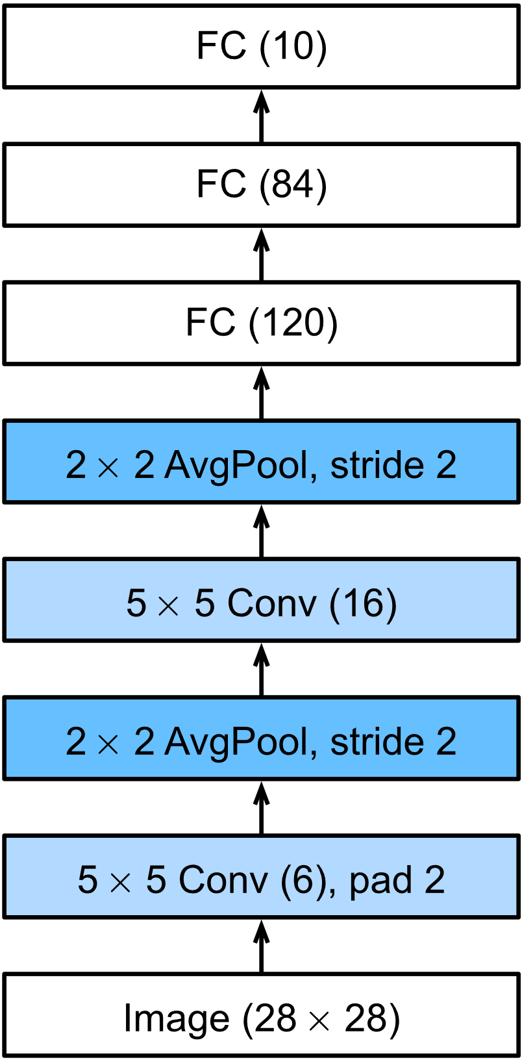
LeNet
Source: d2l.ai

